Slide 2
GLOBAL OIL & GAS ENERGY COMPREHENSIVE INDUSTRIAL GROUP
Research and Development of
High-End Oil & Gas Equipment
Oil & Gas Energy
Engineering as Well as
Oilfield Integrated
Services
Industry Training and Human Resource Services
Industry + Internet Platform Services

Slide 3
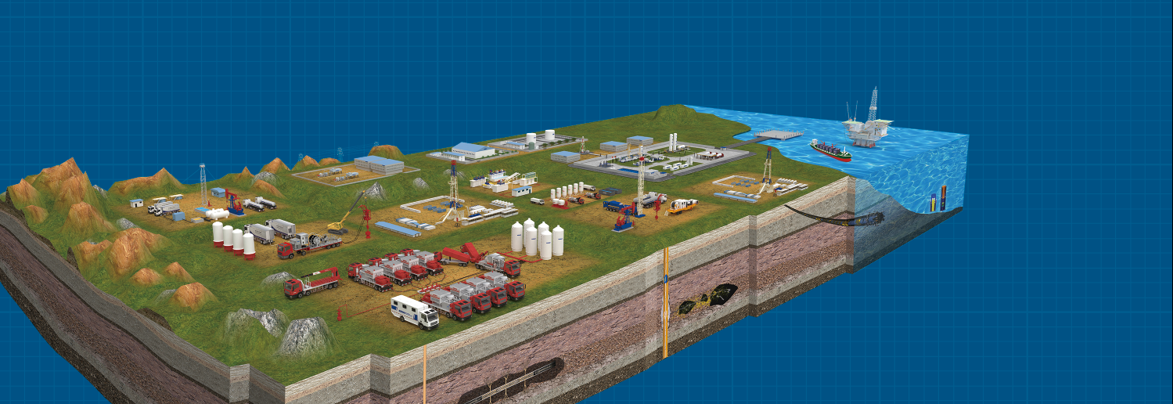
THE DEVELOPMENT AND MANUFACTURE OF HIGH-END OIL AND GAS EQUIPMENT IN THE WHOLE INDUSTRY CHAIN
7
9
100+
Production
Bases
Product
Lines
Product
Categories
The first Chinese supplier to sell a ultra-deep well drilling rig to Saudi Aramco.
China's first reciprocating natural gas compressor package stationed in Egypt.
Provide 10 land rigs and 11 workover rigs in North Africa
Supply 65KM natural gas pipeline to GASCO to supply gas to the new power stations of the Egypt New capital.
China’s first 9000 m ultra-deep well drilling rig exported to Germany.
Presided over the drafting of China's first nitrogen production industry standards

Slide 4
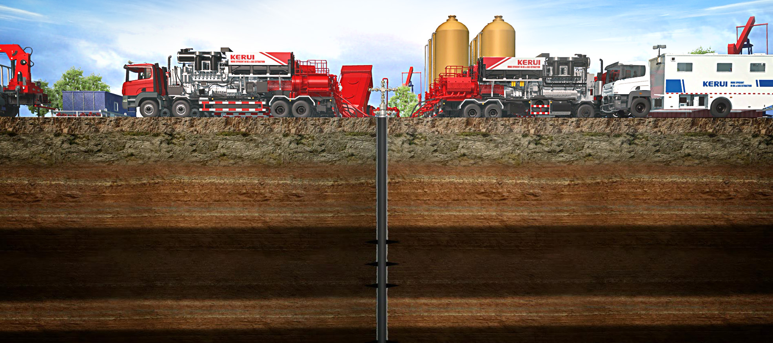
OILFIELD INTEGRATION SERVICES
TOTAL COST OF OIL & GAS PRODUCTION SAVINGS
5%~30%
Exploration and development of oil & gas fields
Oil & Gas drilling
Oil & Gas stimulation
Transformation of the old oilfields
Difficult oilfield development
200+
100+
70%
Engineering Service Teams
Oil & Gas
Blocks
Market Share of Nitrogen Service in China

Slide 5
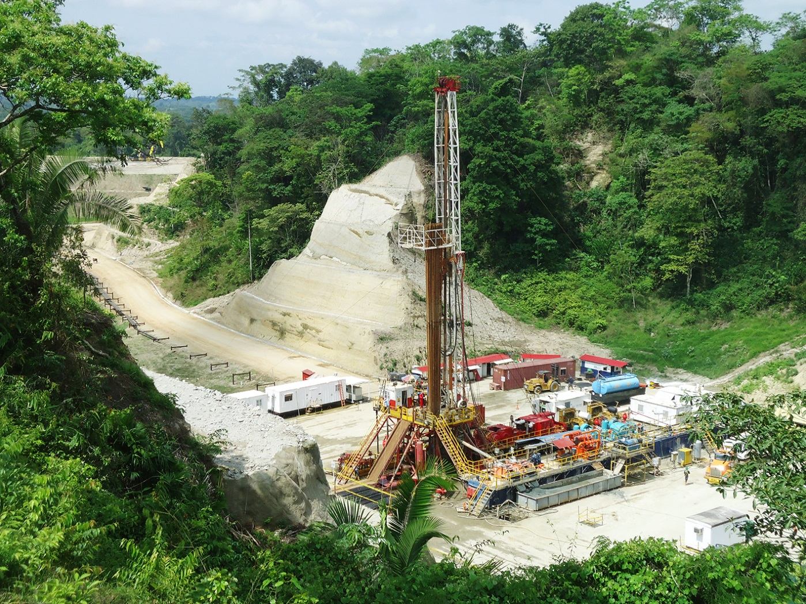
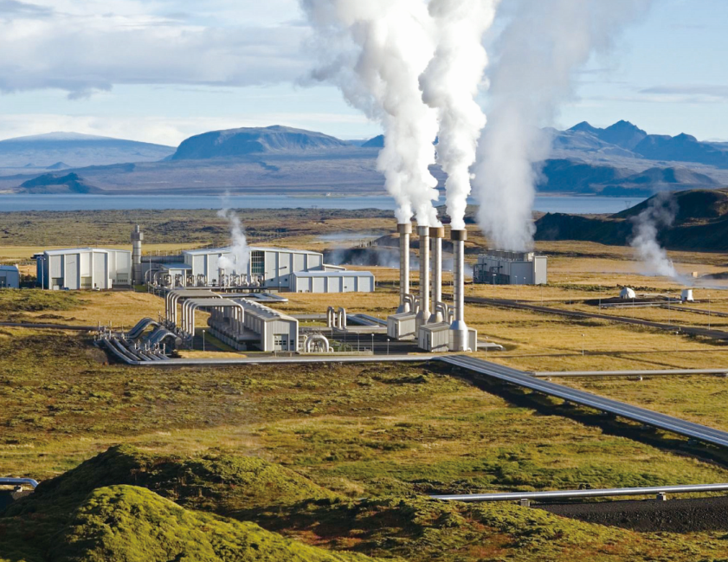
NEW ENERGY DEVELOPMENT SERVICES AND ENERGY
MANAGEMENT CONTRACTING
Design
Consultancy
Project
Contracting
Equipment
Procurement
Equity
Participation
Equipment
Lease
Investment & Operation
Development and services of unconventional
natural gas, including shale gas, coal bed gas and tight gas
Integrated solutions for the geothermal
energy development

Slide 6
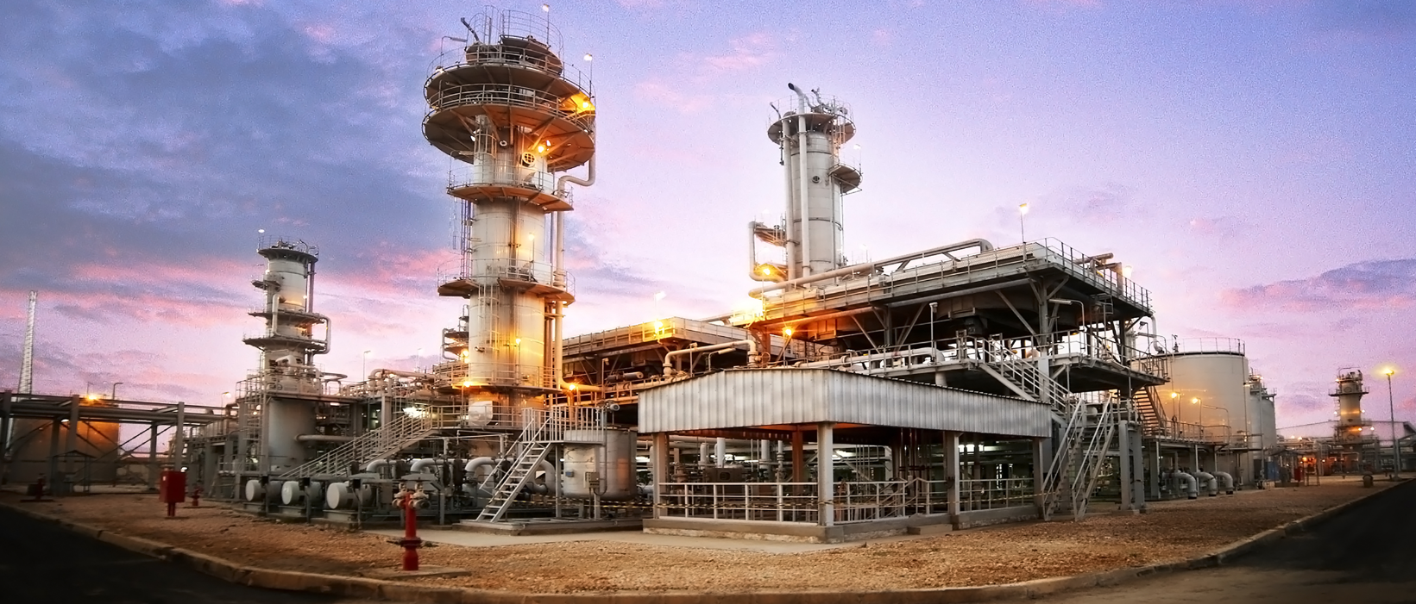
ONE-STOP SOLUTIONS PROVIDER FOR PROJECTS ON THE
OIL & GAS VALUE CHAIN
Pakistan's largest natural gas treatment project（EPCC）
Natural Gas Treatment
ENR Top 225
International Design Firms
Financing Program
Standardized &
Modular Design
Oil & Gas Storage
and Transportation
ENR Top 250
International Contractors
Project Quick Quotation and Economic Analysis
Oil Refining

Slide 7


ONE-STOP PURCHASING PLATFORM FOR THE OIL & GAS
GLOBAL INDUSTRY
High-efficiency one-stop procurement services
Home delivery product consignment
Free on-site service
Technical and personnel support service
Big data of global oil & gas energy industry
Distinguished supply-chain financial service
Full quality control guarantee system

Slide 8


GLOBAL LEADING ONLINE IDLE EQUIPMENT TRADING AND SHARING PLATFORM IN THE OIL & GAS INDUSTRY
Equipment
Evaluation and
Certification
Equipment
Sharing
Technical
Upgrading
Global
Logistics
The Big Data for Equipment
Financial
Solutions

Slide 9

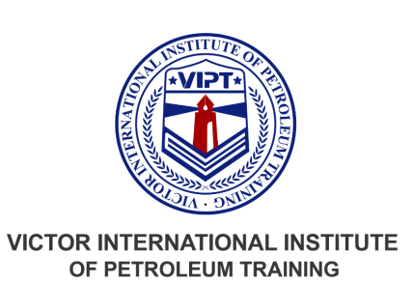
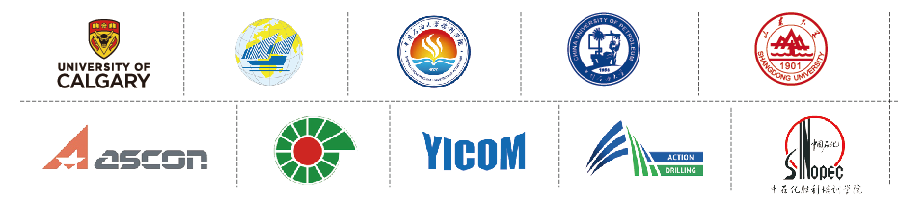

GLOBAL OIL AND GAS ENERGY FIELD TALENT SERVICE SPECIALIST
Talent Training
Services
Human Resources
Services
Petroleum
Engineering
and Technical
Services
International Teaching
Resource Team
"One Network and Three
Think-tanks" Mode

Slide 10

GLOBAL RESOURCE INTEGRATION SERVICES
57
Global Branches
Worldwide
Marketing &
Service Network
33
Local Service Centers
Worldwide
51%
Local Employee Rate
3900+
Suppliers and Partners
Global Supply
Chain Network
Technology
Innovation
16
Technology R&D Centers
5000+
16
Scientific Research Laboratories
The Global Customer Group

Slide 11
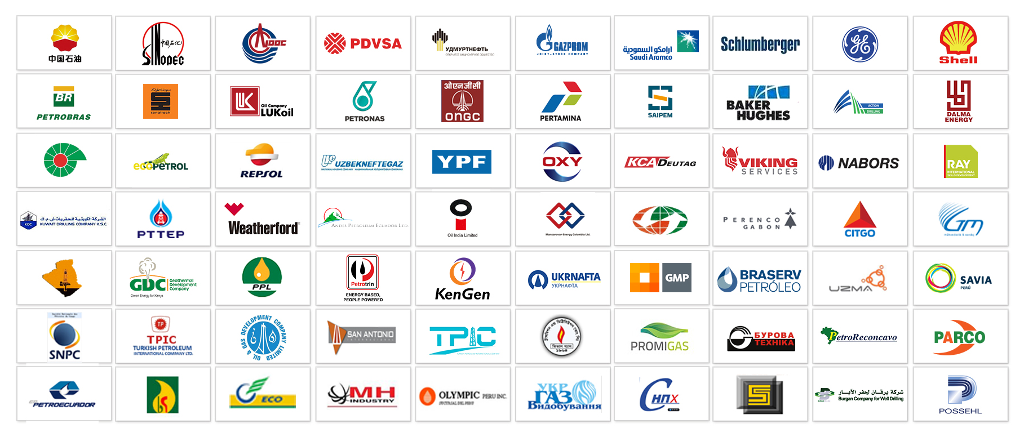

GLOBAL PARTNERS

Slide 12
